Slide 1

ATTENDANCE TRACKER
HARINI B
04.05.2024

Slide 2
Aim of the Project
To create a system to efficiently monitor and manage attendance records for a group of individuals
To reduce the need for manual entry and minimizing errors.
To Integrate the attendance tracking system with existing databases
To Enable real-time updates of attendance status
To generate comprehensive reports and analytics on attendance trends.

Slide 3
Business Problem or Problem Statement
Manual methods of recording attendance are time-consuming, prone to inaccuracies, and lack real-time visibility.
. There is a need for a comprehensive attendance tracking solution that automates the process, ensures accuracy
Manual processes rely heavily on paper-based or spreadsheet systems, resulting in time-consuming data entry
Current attendance tracking methods within our organization are freeof errors, leading to efficiencies and accuracies in managing attendance records.

Slide 4
Project Description
The Attendance Tracking System is a comprehensive software solution
It is designed to streamline the process of monitoring and managing attendance records
The key feature is the "subject" functionality in attendance tracking
It refers to the feature that allows users to specify the subject or course for which attendance is being recorded.

Slide 5
FUNCTIONALITIES
Student Information
Attendance
Subject
Sort
Remove

Slide 6
Student Information:
Maintain individual profiles for each student containing personal information, contact details, and enrollment details
Attendance:
In an attendance tracking system, the attendance function is a core component responsible for recording, managing, and analyzing attendance data.

Slide 7
Subject:
The "subject" functionality in attendance tracking refers to the feature that allows users . to specify the subject or course for which attendance is being recorded.
Remove:
The "remove" function in attendance tracking allows authorized users, such as administrators or teachers, to delete or remove attendance records

Slide 8
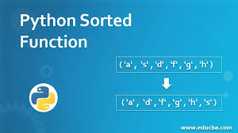
Sort:
Sorting functionality in an attendance tracker can be helpful for organizing attendance records.
Provide the option to sort attendance records alphabetically

Slide 9
ERROR AND EXCEPTION HANDLING
An attendance tracker implemented in Python with input versatility, error handling, and exception handling
The remove_student method removes the records the attendance of a student for a specific roll number.
It checks if the roll number already exist in the records to prevent duplicate entries .
If it does not exist then the error is caught and handled to provide a user-friendly error message.

Slide 10
CODE IMPLEMENTATION
def __init__(sheet, roll_number, subject):
&quot;&quot;&quot;
Initialize a new mark_attendance object.
Args:
- roll_number (int): The roll number of the student.
- subject (str): The subject of the student.
&quot;&quot;&quot;
sheet.roll_number = roll_number
sheet.subject = subject
def mark_attendance(sheet):
&quot;&quot;&quot;
Mark the attendance information of the sheet.
&quot;&quot;&quot;
print(&quot;Roll Number:&quot;, sheet.roll_number)
print(&quot;subject:&quot;, sheet.subject)

Slide 11
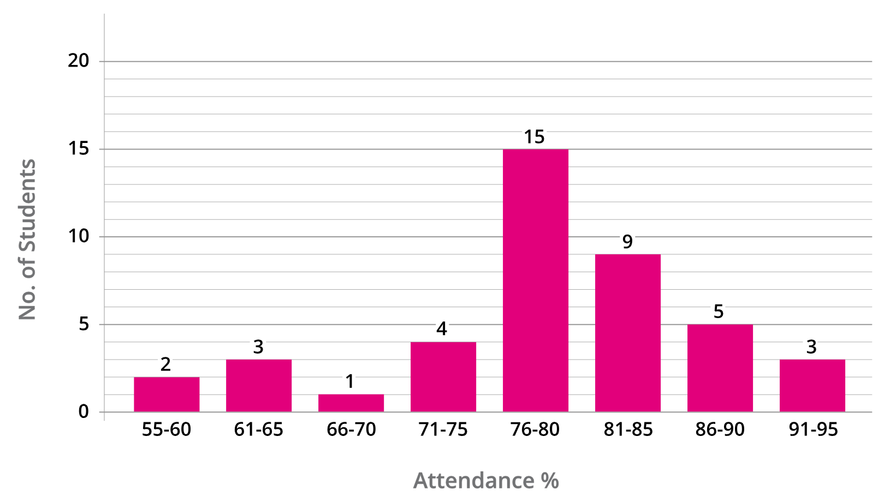
RESULT AND OUTCOME
In an attendance tracking system, various results and outcomes can be achieved, benefiting both educational institutions and organizations.

Slide 12

CONCLUSION
In conclusion, an attendance tracking system is a valuable tool for educational institutions and organizations seeking to streamline attendance management processes, enhance accountability, and make data-driven decisions

